Slide 1
Digital Twins and Real Time Machine Monitoring using Fusion 360 API
Final Project – ISE 555 – Digital Manufacturing
Team Members:
Pavel “Pasha” Koprov
Ashwin Ramachandran

Slide 2
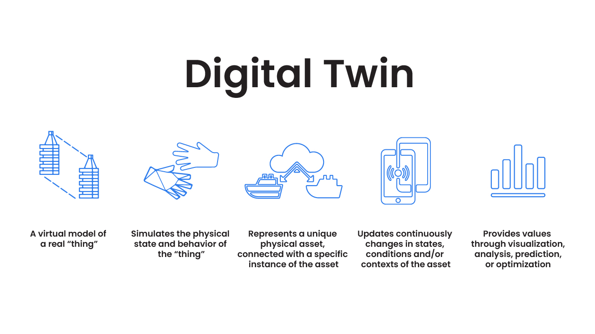
Objectives
To create a “Digital Twin” of a CNC machine and monitor its motion in real time.

Slide 3
Challenges
A Common Data Source (Unified Namespace):
A common data source is required to access the data from anywhere in the world without requiring authentication of the internal network.
Custom Python Modules inside Fusion 360 API
All required modules are not available as part of the Fusion 360 python modules. External installations are required.
Graphic Processing Limitations
Running the digital twin in real-time requires high graphic processing capability as the data flow huge and the animation updates need to be done quickly.

Slide 4
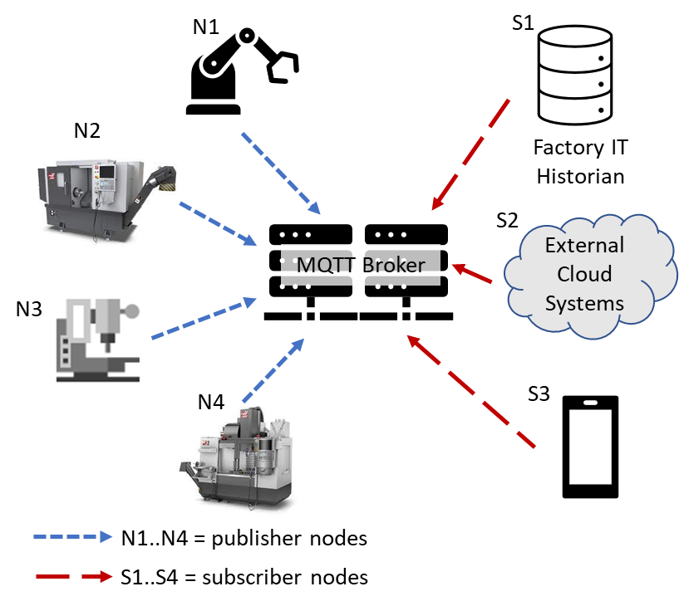
1. MQTT – A Common Data Source

Slide 5
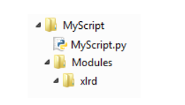
2. Custom Modules For Fusion 360 Scripts
Install all required modules inside a folder where the Script is read from by Fusion 360.
Import using the “from .modules import *” Command

Slide 6
3. Overcoming Graphic Processor Limitations
Machine
0.1s
DataBase
0.1s
Fusion 360
0s
Broker
Solution:
The API has a “doEvents()” function that queues all the values received and executes them according to the machines capability.
This helps in executing this task on any machine easily

Slide 7
Demonstration

Slide 8
Future Work

Slide 9
THANK YOU

